Slide 1

ADULT SALARY
PREDICTION
AAKASH BHANDARI
SHADAB AHMED

Slide 2

CLIENT
CAREERPATH ANALYTICS
CareerPath Analytics is a U.S.-based career development and workforce analytics firm located in Silicon Valley. They specialize in providing data-driven career advice, job market trends analysis, and talent acquisition strategies for tech companies. Their services are geared towards both individuals seeking to advance in the tech industry and tech companies looking for insights into talent acquisition and retention.
GOALS
Guide tech professionals in making informed decisions about career paths, skill development, and educational opportunities that could lead to higher earnings.
Assist tech companies in understanding the characteristics of top earners in the tech industry for targeted recruitment and developing competitive compensation packages.

Slide 3




PROBLEM STATEMENT
Exploring how much people earn in the U.S. to help make better rules for everyone's financial well-being.
Using Machine learning models to figure out what affects people's earnings, aiming to support fair and helpful policies.
Using advanced analysis to decode income patterns, providing a foundation for equitable economic decisions.

Slide 4


DATA SOURCE
"Sourced from the UCI Machine Learning Repository, a renowned source for machine learning datasets."
KEY FEATURES
"The dataset encompasses over 48,842 records, each representing an individual adult in the U.S.
"It covers a diverse range of demographic and socio-economic factors, providing a comprehensive view of the adult population's income dynamics.

Slide 5
CATEGORICAL
NUMERICAL
WORKCLASS
EDUCATION
MARITIAL_STATUS
OCCUPATION
RELATIONSHIP
RACE
SEX
NATIVE-COUNTRY
EARNING_POTENTIAL
AGE
FNLWGT
EDUCATION-NUM
CAPITAL-GAIN
CAPITAL-LOSS
HRS_PER_WEEK
REALLYGREATSITE.COM

Slide 6


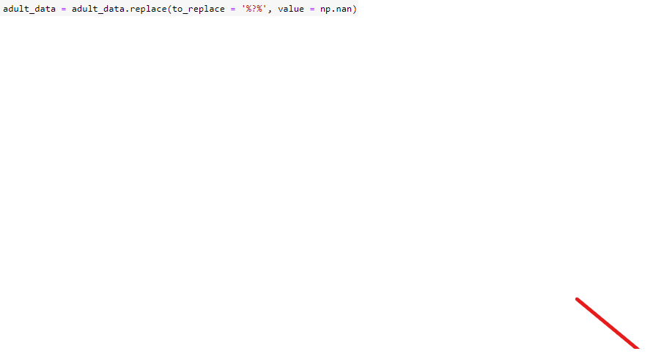

DATA PREPROCESSING
MISSING VALUE TREATMENT
First, we replace all “?” with NaN
Secondly, we replace those NaN with Mode and Median for categorical and numerical value resp.
LABEL ENCODING
To convert Categorical data into numerical format. The main reason to use label encoding is for ease, efficiency, and simplicity.
Ex-
Sex (Female-0, Male-1)
Earning_potential (<=50k : 0, >=50k : 1)

Slide 7
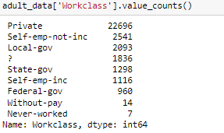
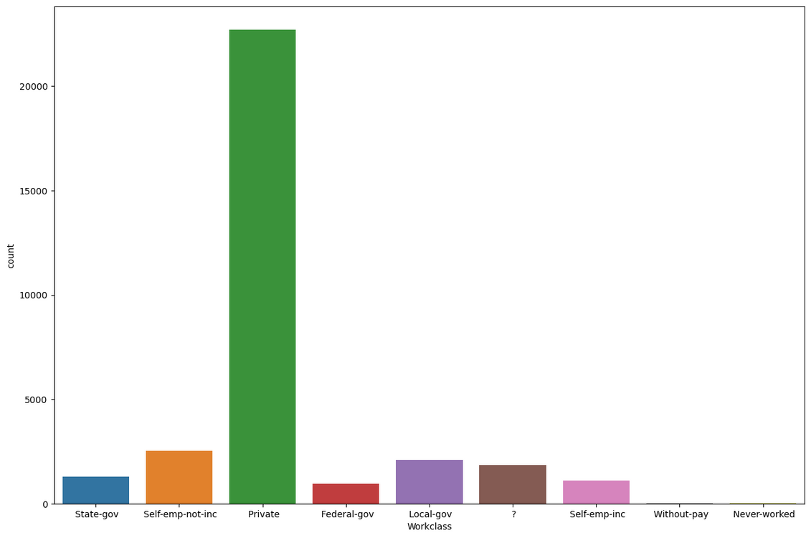
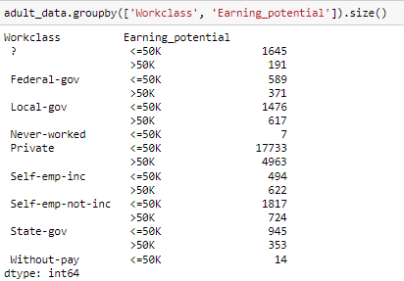
DATA ANALYSIS
CATEGORICAL ANALYSIS
WORKCLASS

Slide 8
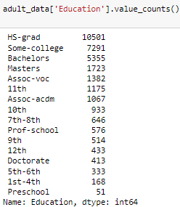
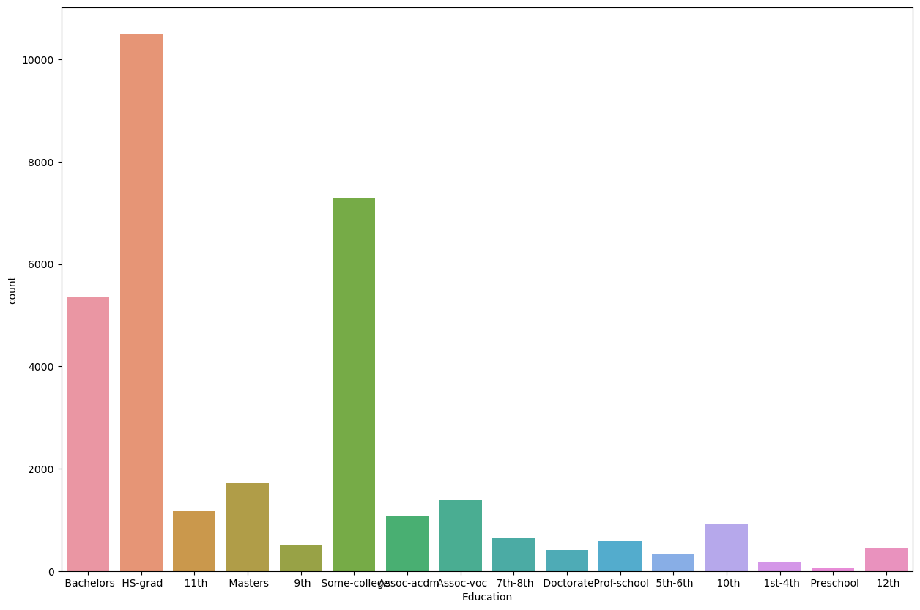
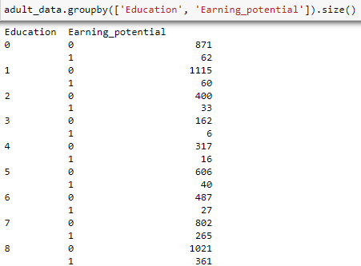
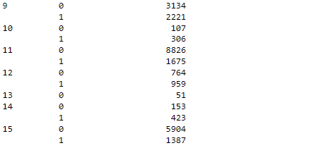
DATA ANALYSIS
CATEGORICAL ANALYSIS
EDUCATION

Slide 9
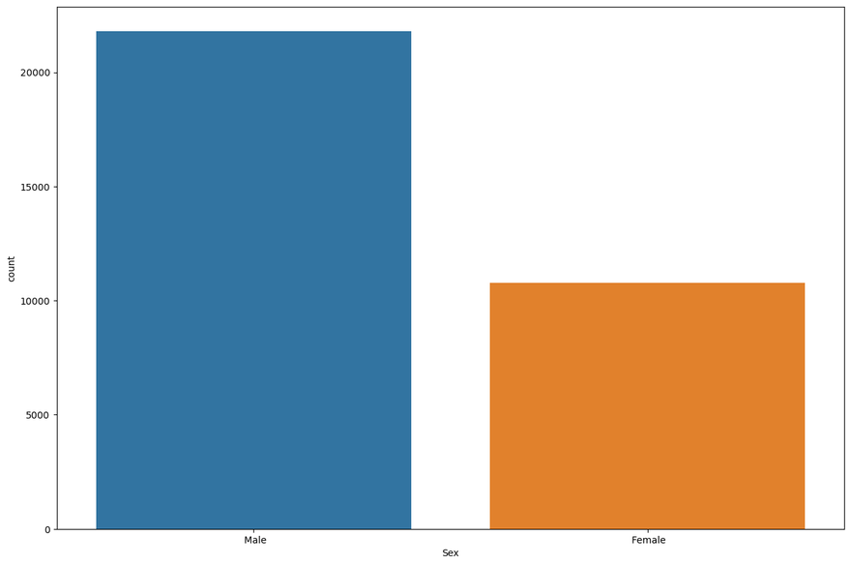
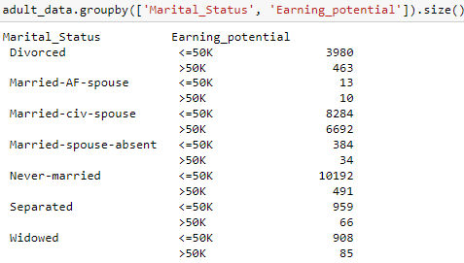
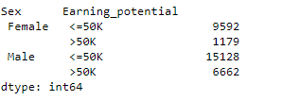
DATA ANALYSIS
CATEGORICAL ANALYSIS
MARITIAL_STATUS
SEX

Slide 10
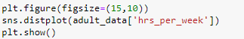
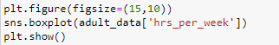
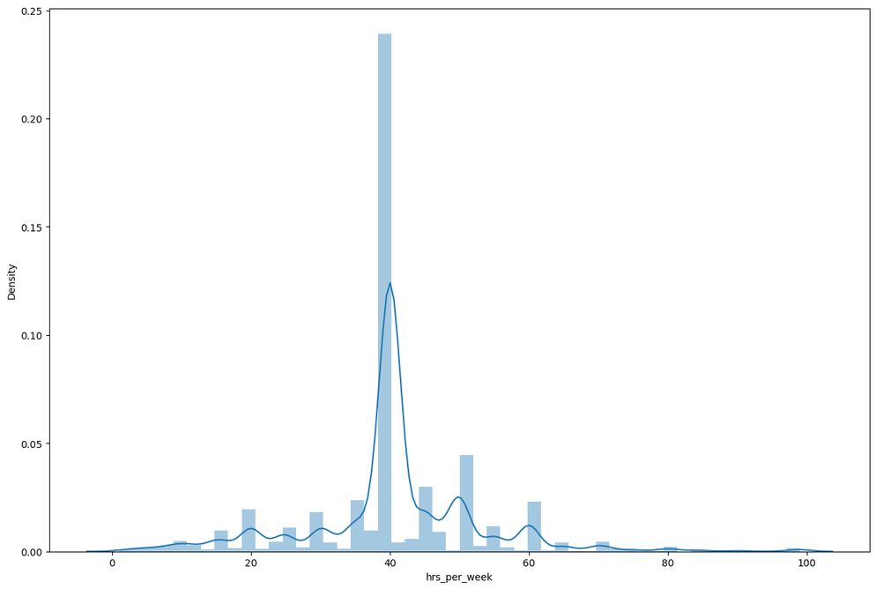
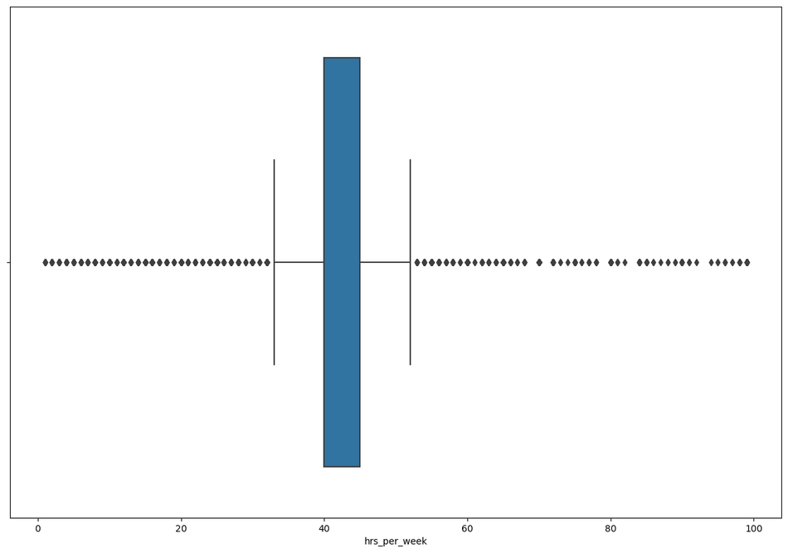
DATA ANALYSIS
NUMERICAL ANALYSIS
HOURS PER WEEK
LOT OF PEOPLE WORK AROUND 40 HOURS PER WEEK

Slide 11
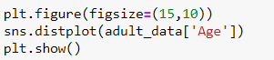
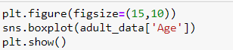
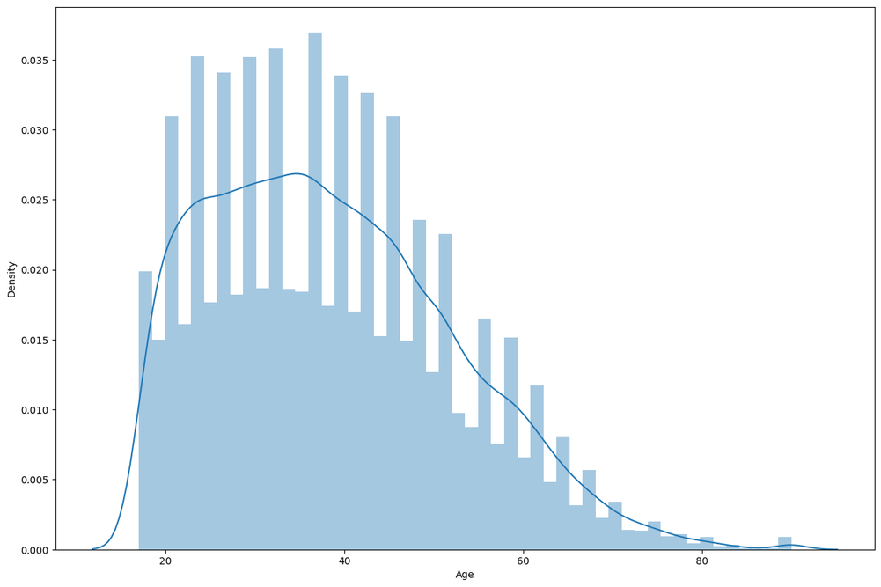
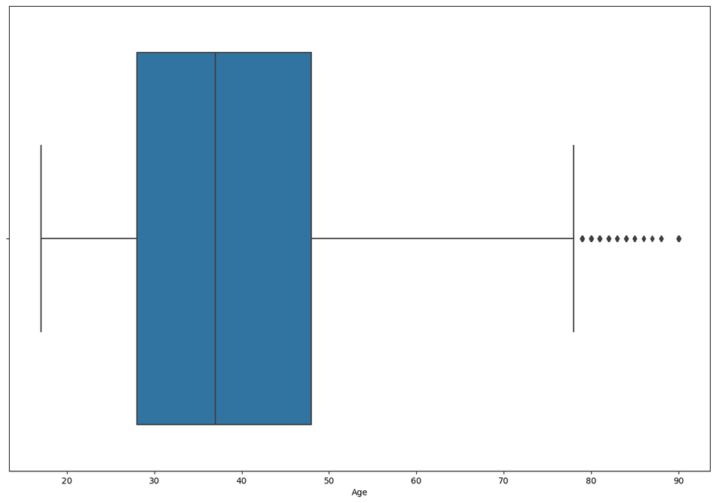
DATA ANALYSIS
NUMERICAL ANALYSIS
AGE
THE AGE IS RIGHT SKEWED AS MORE PEOPLE AT AN YOUNGER AGE WORK IN THIS SURVEY.

Slide 12
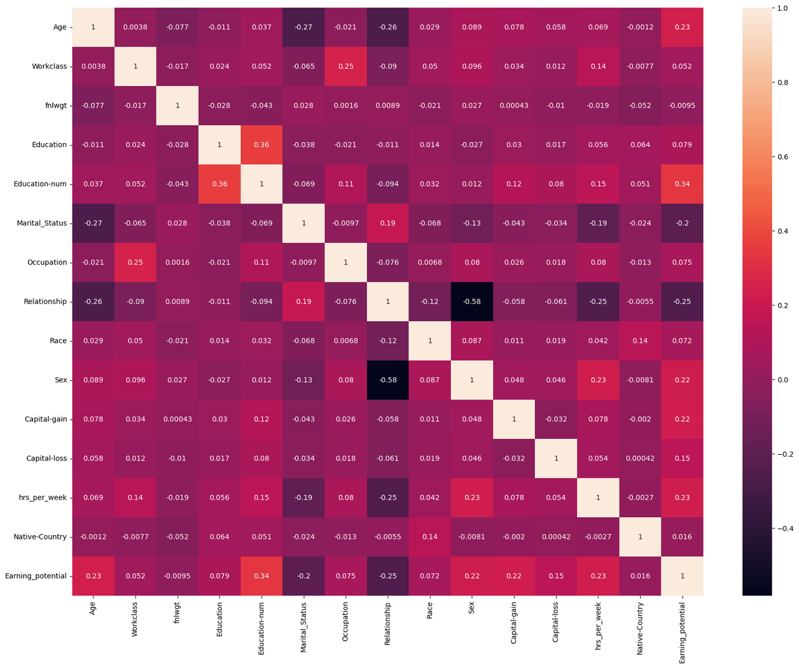
COORELATION
COOR 1 : EDUCATION AND EDUCATION-
NUM (HIGH POSITIVE)
COOR 2 : RELATIONSHIP AND SEX (STRONG NEGATIVE)
COOR 3 : CAPITAL-GAIN VS EARNING POTENTIAL (POSITIVE)
COOR 4 : HOURS/WEEK VS EARNING POTENTIAL (POSITIVE)
COOR 5 : AGE VS MARITIAL STATUS (NEGATIVE)

Slide 13
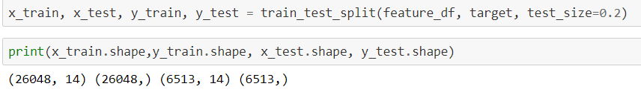
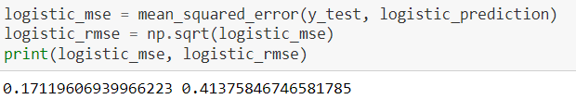
LOGISTIC REGRESSION
USING LR BECAUSE BIVARIATE NATURE OF TARGET COLUMN (EARNING POTENTIAL)
HERE WE TRAIN THE DATA USING TRAIN-VALIDATION-TEST SPLITTING
HERE WE ALSO TEST MEAN SQUARE ERROR FOR THIS MODEL
BY HAVING ERROR RESULT, WE GOT TO KNOW LOGISTIC REGRESSION DOEST NOT PERFORM WELL, ALSO BECAUSE WE HAVE MULTIPLE FEATURES WHICH MAKES IT MORE DIFFICULT TO PREDICT VALUES.

Slide 14
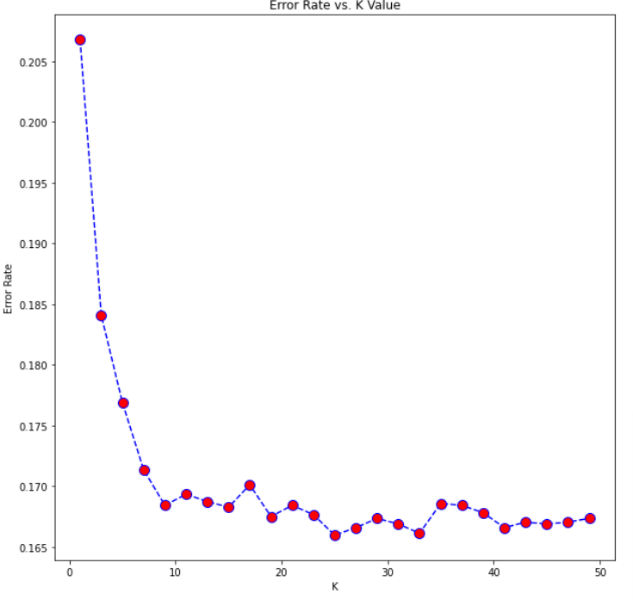
KNN CLASSIFIER
HERE WE USE OUR ALREADY MADE TRAIN AND TEST DATA .
DECREASING TREND - FROM 1 TO 7, WHIC MEANS K VALUE OF 1 LEADS TO MODEL THAT IS OVERFITTED (LOT OF NOISE IN TRAINING DATA) WHICH RESULT INTO HIGH ERROR WHEN PREDICTING NEW DATA FROM TEST DATA.
STABILIZATION- THIS INDICATES INCREASING K FURTHER DOESNOT RESULT IN INPROVEMENT IN ACCURACY. THIS IS BECAUSE, BEYOND CERTAIN POINT, ADDING MORE NEIGHBOUR DOEST NOT CONTRIBUTE NEW INFORMATION FOR PREDICTION.
INCREASING K BEYOND OPTIMAL POINT - INCREASE IN K BEYOND OPTIMAL POINT RESULT INCREASE IN ERROR, WHICH INDICATE THAT MODEL IS STARTING INCLUDE IRRELEVANT POINTS WHICH ARE NOT USEFULFOR PREDICTION.
OPTIMAL POINT - K VALUE THAT MINIMIZES THE ROOR RATE. HERE IN GRAPH WE CAN SAY THAT 25 IS THE APRROX OPTIMAL POINT FOR THIS MODEL.

Slide 15
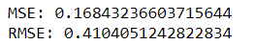
AFTER CALCULATING MEAN SQUARE ERROR AND ROOT MEAN SQUARE ERROR, WE GOT TO KNOW THAT THESE VALUES ARE PRETTY LOW AS COMPARE TO LOGISTIC REGRESSION

Slide 16

CONCLUSION
Private sector working, High school Graduate, Never married, Male people making more than 50k $.
Most of the people are working around 40 hours per week.
Also, Younger people tends to make more money than older ones.

Slide 17
THANKYOU

